Slide 1


Butterfly/NTT
Mariam Rabadi
Hardware Acceleration
College of Engineering and Computer Science

Slide 2
Outline:
1. Fixed errors in previous slides (butterfly base code).
2. Found error in HEAX paper code by mapping it onto the base code
3. Derived a butterfly with n=4 elements, fixed error in Conceptual Review paper.
4. Started on the hardware implementation of the algorithm in the HEAX paper.
5. Met with John to discuss implementing an NTT function (in the architecture) based on the code. Discussed some code optimization.

Slide 3
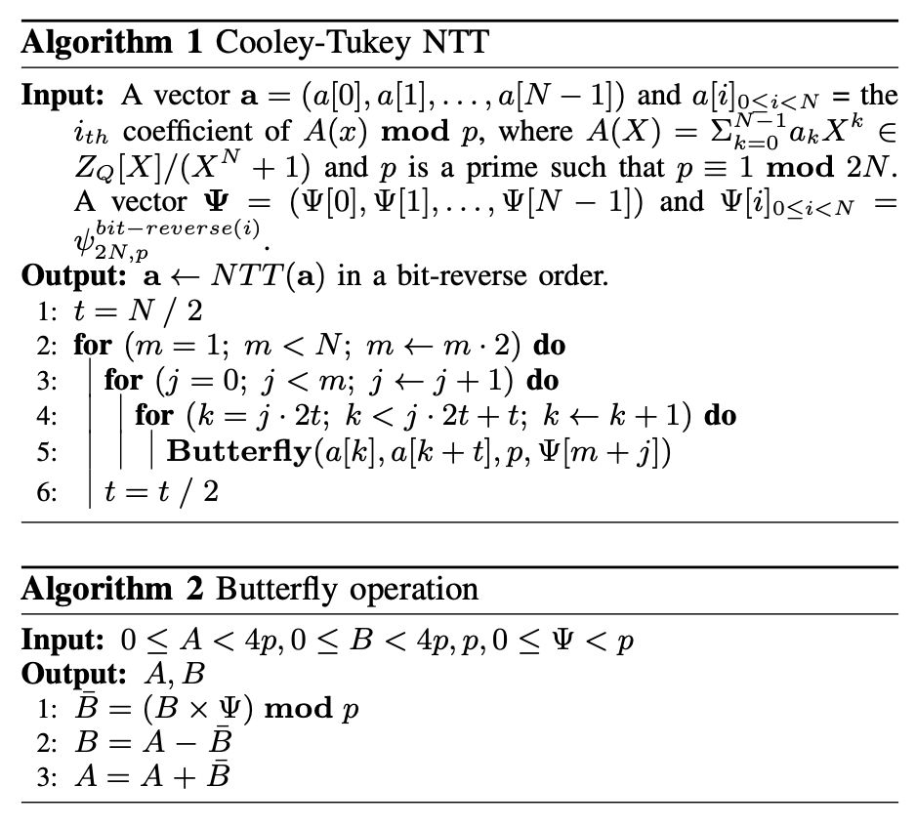
Butterfly code
Notes:
Accelerating Number Theoretic Transformations for Bootstrappable Homomorphic Encryption on GPUs
Number Theoretic Transform and Its Applications in Lattice-based Cryptosystems: A Survey

Slide 4
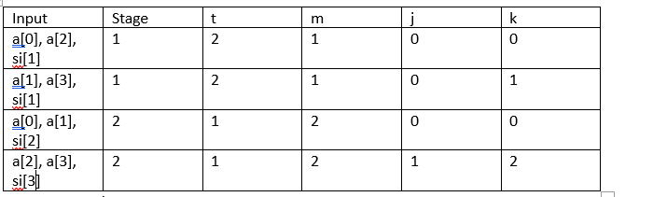
What are the different variables used for?
Simple example using N=4
Requires more analysis to see use of variables other than M.

Slide 5
Use N=16
Input | describe | t | m | j | k
a[0],a[8], si[1] |  | 8 | 1 | 0 | 0
a[1],a[9], si[1] |  | 8 | 1 | 0 | 1
a[2],a[10], si[1] |  | 8 | 1 | 0 | 2
a[3],a[11], si[1] |  | 8 | 1 | 0 | 3
a[4],a[12], si[1] |  | 8 | 1 | 0 | 4
a[5],a[13], si[1] |  | 8 | 1 | 0 | 5
a[6],a[14], si[1] |  | 8 | 1 | 0 | 6
a[7],a[15], si[1] |  | 8 | 1 | 0 | 7

Slide 6
a[0],a[4], si[2] | . | T=4 | M=2 | J=0 | K=0
a[1],a[5], si[2] |  | 4 | 2 | 0 | 1
a[2],a[6], si[2] |  | 4 | 2 | 0 | 2
a[3],a[7], si[2] |  | 4 | 2 | 0 | 3
a[8],a[12], si[3] |  | 4 | 2 | 1 | 8
a[9],a[13], si[3] |  | 4 | 2 | 1 | 9
a[10],a[14], si[3] |  | 4 | 2 | 1 | 10
a[11],a[15], si[3] |  | 4 | 2 | 1 | 11

Slide 7
a[0], a[2], si[4] |  | T=2 | M=4 | J=0 | K=0
a[1],a[3],si[4] |  | 2 | 4 | 0 | 1
a[4],a[6], si[5] |  | 2 | 4 | 1 | 4
a[5],a[7], si[5] |  | 2 | 4 | 1 | 5
a[8],a[10], si[6] |  | 2 | 4 | 2 | 8
a[9],a[11], si[6] |  | 2 | 4 | 2 | 9
a[12],a[14], si[7] |  | 2 | 4 | 3 | 12
a[13],a[15],si[7] |  | 2 | 4 | 3 | 14

Slide 8
a[0],a[1], si[8] |  | T=1 | M=8 | J=0 | K=0
a[2],a[3], si[9] |  | 1 | 8 | 1 | 2
a[4],a[5], si[10] |  | 1 | 8 | 2 | 4
a[6],a[7], si[11] |  | 1 | 8 | 3 | 6
a[8],a[9], si[12] |  | 1 | 8 | 4 | 8
a[10],a[11], si[13] |  | 1 | 8 | 5 | 10
a[12],a[13], si[14] |  | 1 | 8 | 6 | 12
a[14],a[15], si[15] |  | 1 | 8 | 7 | 14

Slide 9

Notes:
Stage is log m

Slide 10
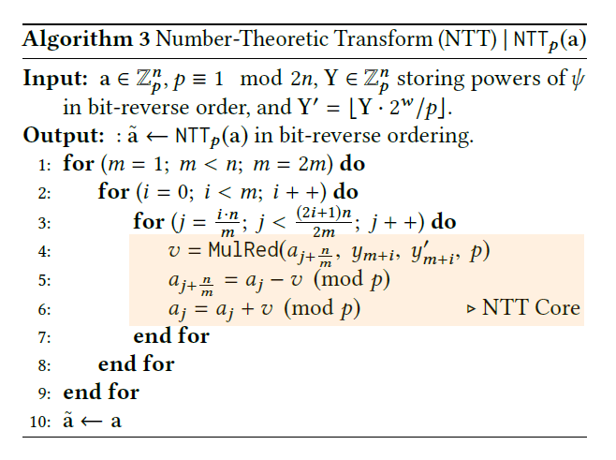
Code in HEAX PAPER. How does it translate?
Notes:
HEAX: An Architecture for Computing on Encrypted Data

Slide 11
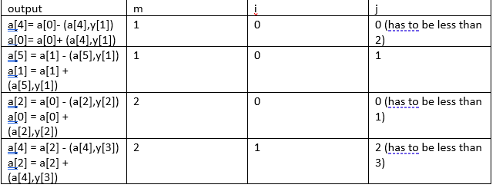
Uses a butterfly to accelerate the process
MulRed multiplies the first two inputs and mods them by q
Table representation with n = 4. There is an error in their code

Slide 12
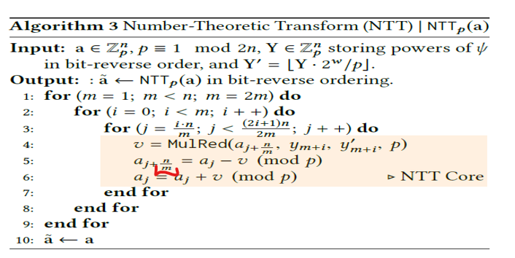
HEAX code vs Base code
m = m
i = j
j = k
t = n/2m (divided by 2 each time m is iterated)
Since k = 2*j * t then j = 2*i*n/2m = i*n/m
k < 2*j*t +t so j=i*n/m + n/2m = n*(2i+1)/2m
a[k+t] = a[j+n/2m)
Error in line 5

Slide 13
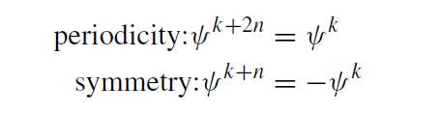
Mathematically deriving a butterfly for n = 4:
Some useful properties:

Slide 14
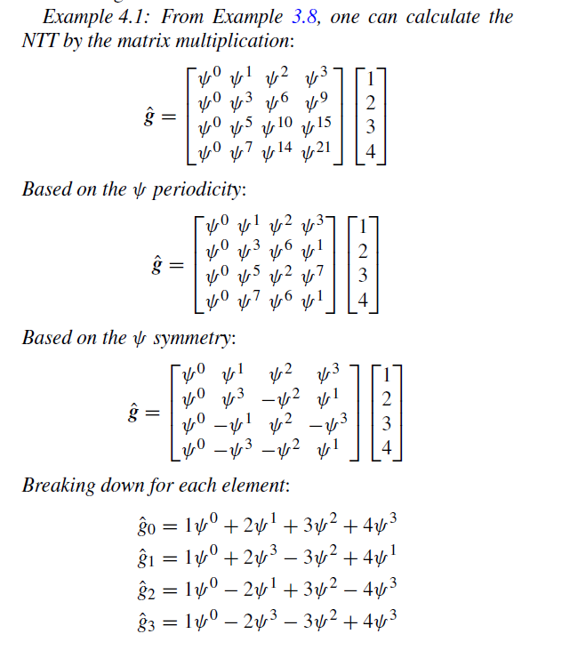
Notes:
Conceptual Review on Number Theoretic Transform and Comprehensive Review on Its Implementations

Slide 15
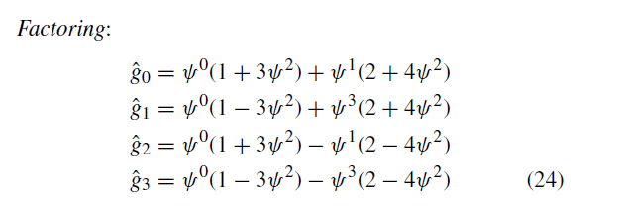
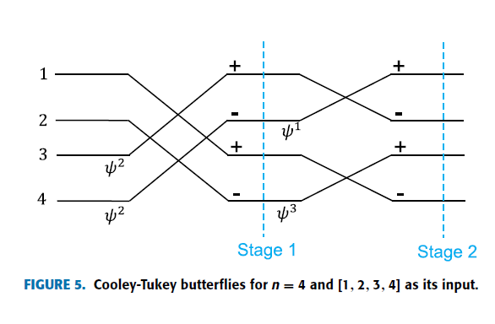
Error in their math and butterfly

Slide 16


Slide 17
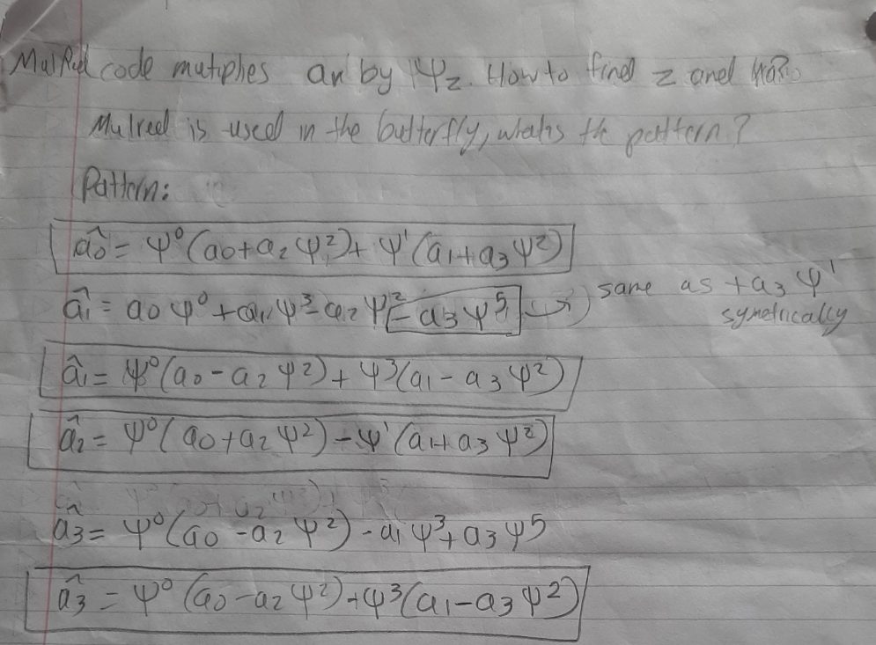

Slide 18
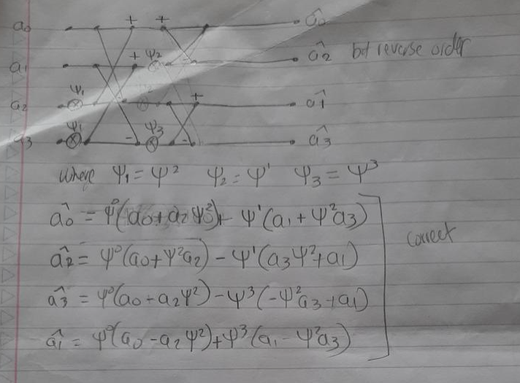

Slide 19
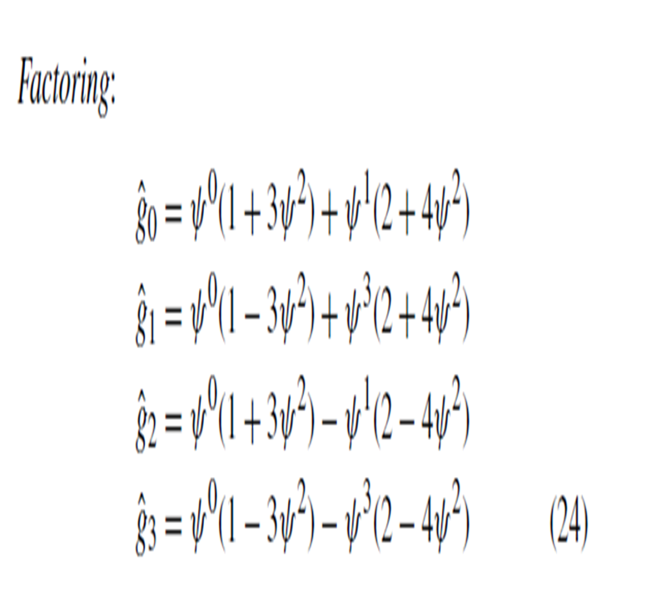
Comparison

Slide 20
Pitfalls:
1. Not doing it by hand: there are errors in most papers, do the math by hand to avoid getting confused by an error (focusing on the math you care about, doing the math for everything wastes time).
2. Not doing examples: looking at an equation is not enough, create examples of inputs and constants to get a feel of how the process works with real numbers, not just symbols.
Advice: try to derive; Best way to map a butterfly is to derive (like in the slides before). Hard to do when there are a lot of inputs, but doing it for a small n helps you to understand where the equations come from.
Separate NTT from the butterflies. NTT is an equation, butterfly is a way to accelerate the computation.

Slide 21
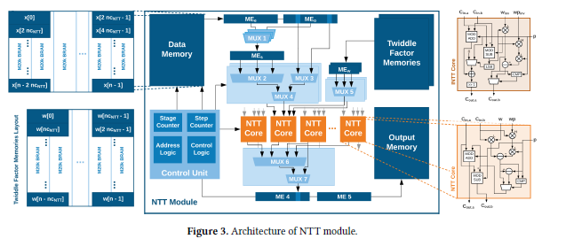
Architecture in HEAX paper

Slide 22
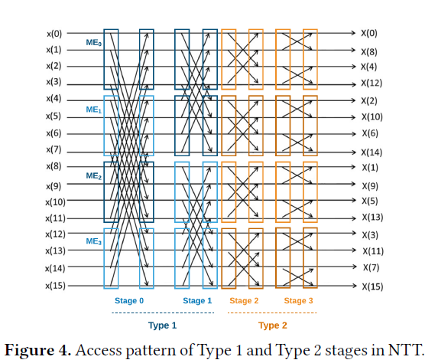
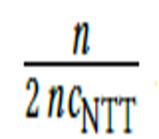
Access pattern
nCNNT = number of NTT cores.
We need
Steps to finish one stage. n is the number of inputs (in this case 16).
This figure shows 4 cores, as 2 * number of cores elements are done in one step. There are 2 steps, so 2*2*4=16.

Slide 23
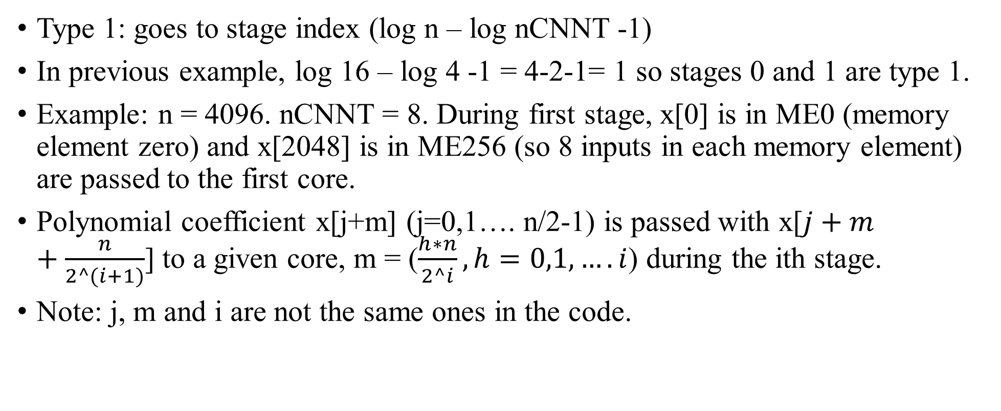
Two different types
Type 1: goes to stage index (log n – log nCNNT -1)
In previous example, log 16 – log 4 -1 = 4-2-1= 1 so stages 0 and 1 are type 1.
Example: n = 4096. nCNNT = 8. During first stage, x[0] is in ME0 (memory element zero) and x[2048] is in ME256 (so 8 inputs in each memory element) are passed to the first core.
Polynomial coefficient x[j+m] (j=0,1…. n/2-1) is passed with x[$j+m+\frac{n}{2^(i+1)}$] to a given core, m = ($\frac{h∗n}{2^i}, h=0,1,….i$) during the ith stage.
Note: j, m and i are not the same ones in the code.

Slide 24
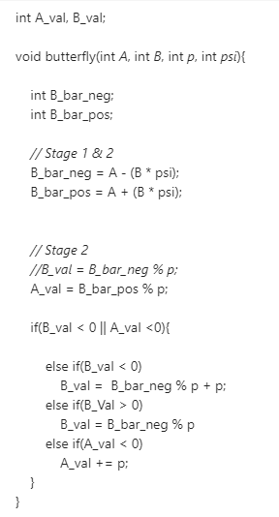
NTT as part of the architecture

Slide 25
Things to explore/ Next steps:
How is the number of memory elements determined? Equation: n/(nCNTT) seems consistent for more simple cases and with the paper “In Type 1 stages, coefficients within two fetched MEs are always accessed in the same order. For example, the second coefficient in each ME is always passed to the second NTT core.” so nCNTT = number of elements in each ME. What is an encompassing equation? What about type 2 stages?
The architecture shows only two memory elements, MEe and MEo, but the paper explores ME0 and ME256, how to relate those two to each other.
Full Hardware implementation of HEAX paper.
Work with John on full NTT code.

Slide 26


Thank you!

